Slide 1

CSC3100 Data Structures
Tutorial 4

Slide 2
Roadmap
List Concept
Linked List Concept
Linked List Exercise

Slide 3
List - Recall
A list represents a countable number of ordered values, where the same value may occur more than once.
Advantages：
Do not use contiguous memory to complete dynamic operations.
Insert and delete operations for easy insertion and removal internally
Push and pop can be performed at both ends
First
……
Second
Last
https://en.wikipedia.org/wiki/List_(abstract_data_type)

Slide 4
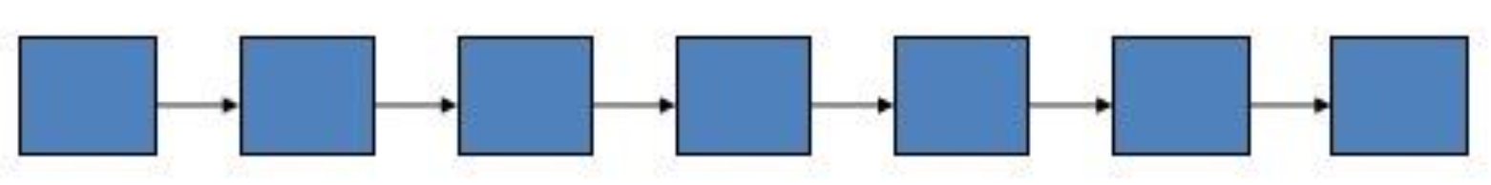
Linked List
A linked list is a linear collection of data elements whose order is not given by their physical placement in memory. Instead, each element points to the next. It is a data structure consisting of a collection of nodes which together represent a sequence. In its most basic form, each node contains: data, and a reference (in other words, a link) to the next node in the sequence.
This structure allows for efficient insertion or removal of elements from any position in the sequence during iteration.
Linked list - https://en.wikipedia.org/wiki/Linked_list

Slide 5
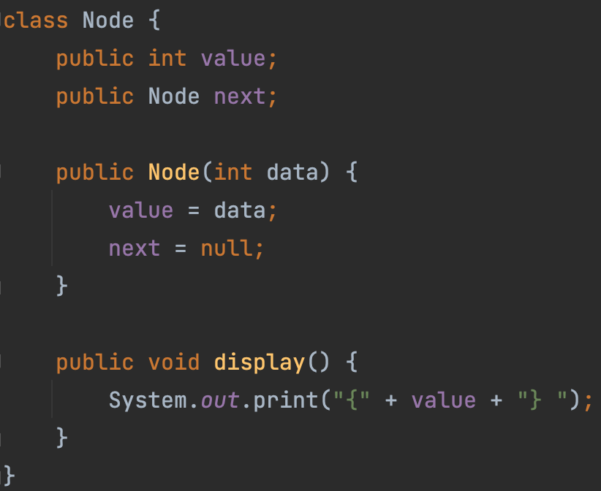
Node in Linked List

Slide 6
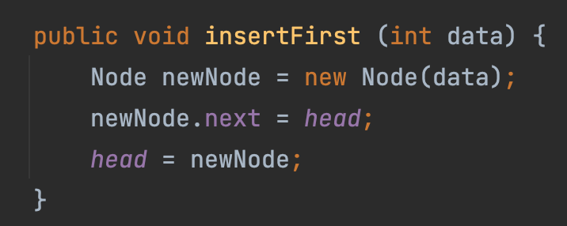
Basic Operations
insertFirst
insertLast
deleteFirst
deleteAfter

Slide 7

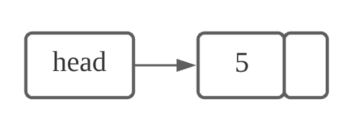


Toy Example
linkedList myLinkedList = new linkedList();
myLinkedList.insertFirst(5);
myLinkedList.insertFirst(4);
myLinkedList.insertFirst(3);
myLinkedList.insertFirst(2);
myLinkedList.insertFirst(1);

Slide 8
Exercise
Please find the template code for Linked List on BlackBoard and complete print(), reversePrint() and oddPrint() function.
  Print(): output the linked list (from head to tail).
    Result: 1 → 2 → 3 → 4 → 5
  reversePrint(): output the linked list (from tail to head).
    Result: 5 → 4 → 3 → 2 → 1
  oddPrint(): output odd nodes forward and then backward.
    Result: 1 → 3 → 5 → 5 → 3 → 1

Slide 9
Question
Given a head node of a Linked List, we know that it is a singly linked list. How to verify whether it is a circular linked list?

Slide 10
Q & A

